Slide 1

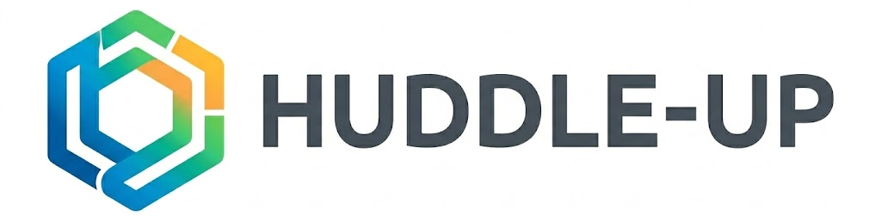
A micro-community social media website version
Project is provided here
Presented by: Moses, Megha, Sam, Amisha

Slide 2
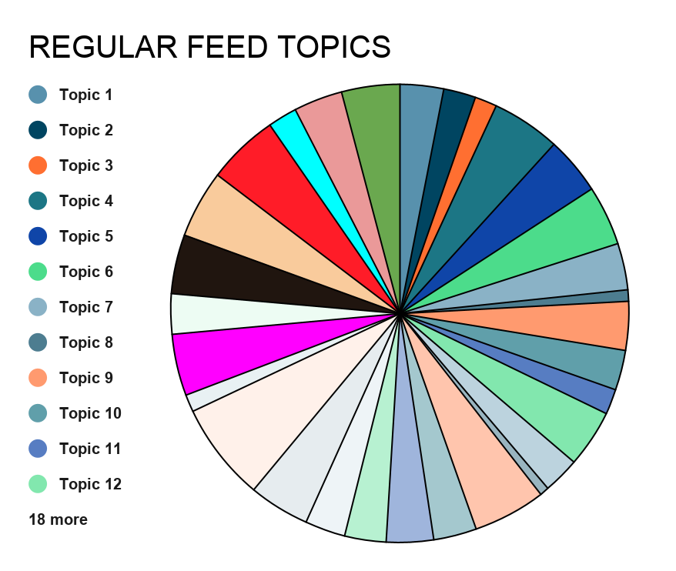
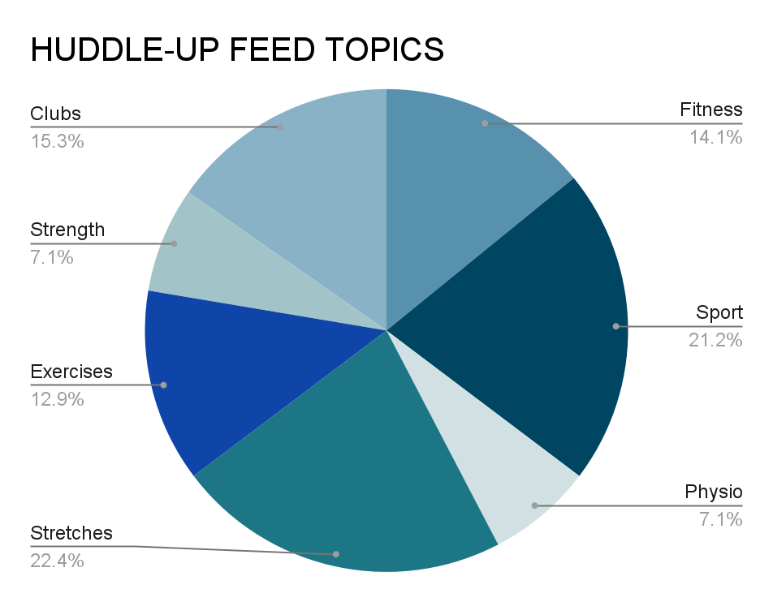
What our project is for
“Huddles” - Micro community that is a private
chat/feed that focuses on a shared topic
WHY WE MADE HUDDLE-UP
LESS Noisy
LESS Toxic
MORE personalised content
MORE Focused Discussion
SMALLER, trusted groups
Platforms we used to build our project - WebWave
What is our project chosen and what was it about?
HuddleUp is a social media app built around micro communities (“huddles”) instead of public feeds. A huddle is a small private group of people who share a goal or interest. Users join huddles for fitness, study, hobbies, mental health support, projects, and more.
Why did we choose this idea for our project?
People have friends and followers, but still feel lonely. Big social platforms are noisy, algorithm-driven, and often toxic. So, it is hard to find a small, trusted group online where everyone is heard.
Platforms we used to build our project - WebWave
Notes:
What is our project chosen and what was it about?
HuddleUp is a social media app built around micro communities (“huddles”) instead of public feeds. A huddle is a small private group of people who share a goal or interest. Users join huddles for fitness, study, hobbies, mental health support, projects, and more, creating a close community where you are able to connect with likeminded people naturally based on a shared interest/topic, creating meaningful connections
Why did we choose this idea for our project?
People have friends and followers, but still feel lonely. Big social platforms are noisy, algorithm-driven, and often toxic. So, it is hard to find a small, trusted group online where everyone is heard, creating a close community.

Slide 3
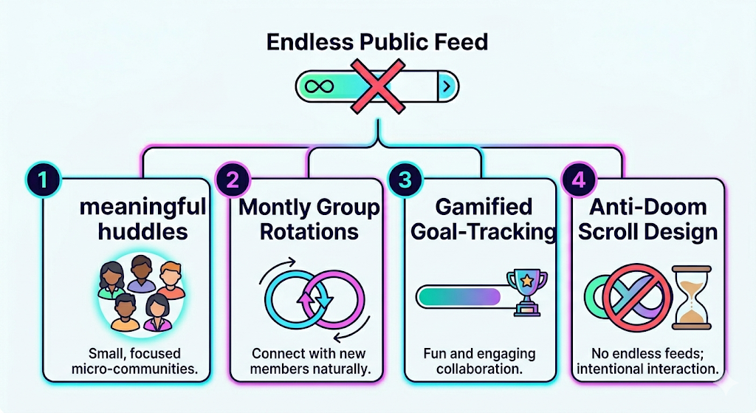
Our USP
Notes:
What is a USP
USP stands for unique selling proposition. It is a concise statement that identifies what makes a product, service, business or brand stand out from competitors and why customers should choose it over others in the market.
Reasons why this app is unique
Huddle‑up stands out because it replaces large, noisy social spaces with small, focused micro‑communities. Instead of an endless feed, users join a few meaningful huddles that encourage real interaction. The app also offers optional monthly group rotations to help people connect with new members naturally, and it uses gamified goal‑tracking to keep collaboration fun and engaging. Which gives it a more meaningful interaction/discussion.

Slide 4
Branding, marketing & advertising future growth
Branding | Marketing | Advertising future growth
-Name: Huddle-up -Slogan: “Small circles, big connections.” -Design: Soft, welcoming colors representing trust and energy. Purple/Green/Orange Target audience -Aged 18-35 Demographic: Students, remote workers, hobbyists, and people seeking real online community experiences. | -Launch through schools, university clubs, co-working spaces, and hobby communities. -Social advertisements. Our slogan: “find your people, not your followers.” -Having influencers or users sharing how Huddle Up app fosters “real conversation.” -Partnerships with online learning platforms — every course can have a Huddle for discussion | - Having B2B partnerships with online learning platforms (education, wellness brands) -AI-powered group matching: Suggest new huddles based on participation style and interests. -Event integration: Turn online huddles into real-life meetups through built-in event planning. -Cross-platform growth: Expanding tools to schools, therapy groups, and creative collaborations. -To be expanded for application use

Slide 5

Social media channels/platforms
Platforms: Youtube, Instagram specifically Threads, Whatsapp
Email marketing: Users can sign up through advertising links delivered through instagram.
Segmentation: users when signed up with the website are divided into’ mini huddles’ based on their interests.
Promotion: run adverts, word of mouth, through schools/ university, therapy groups, Billboards at high footfall areas near libraries.
Experiential marketing: Videos of pop ups of our brand interacting with members of the public in order to boost awareness: Hosting small groups with a photobooth and HuddleUp memorabilia

Slide 6
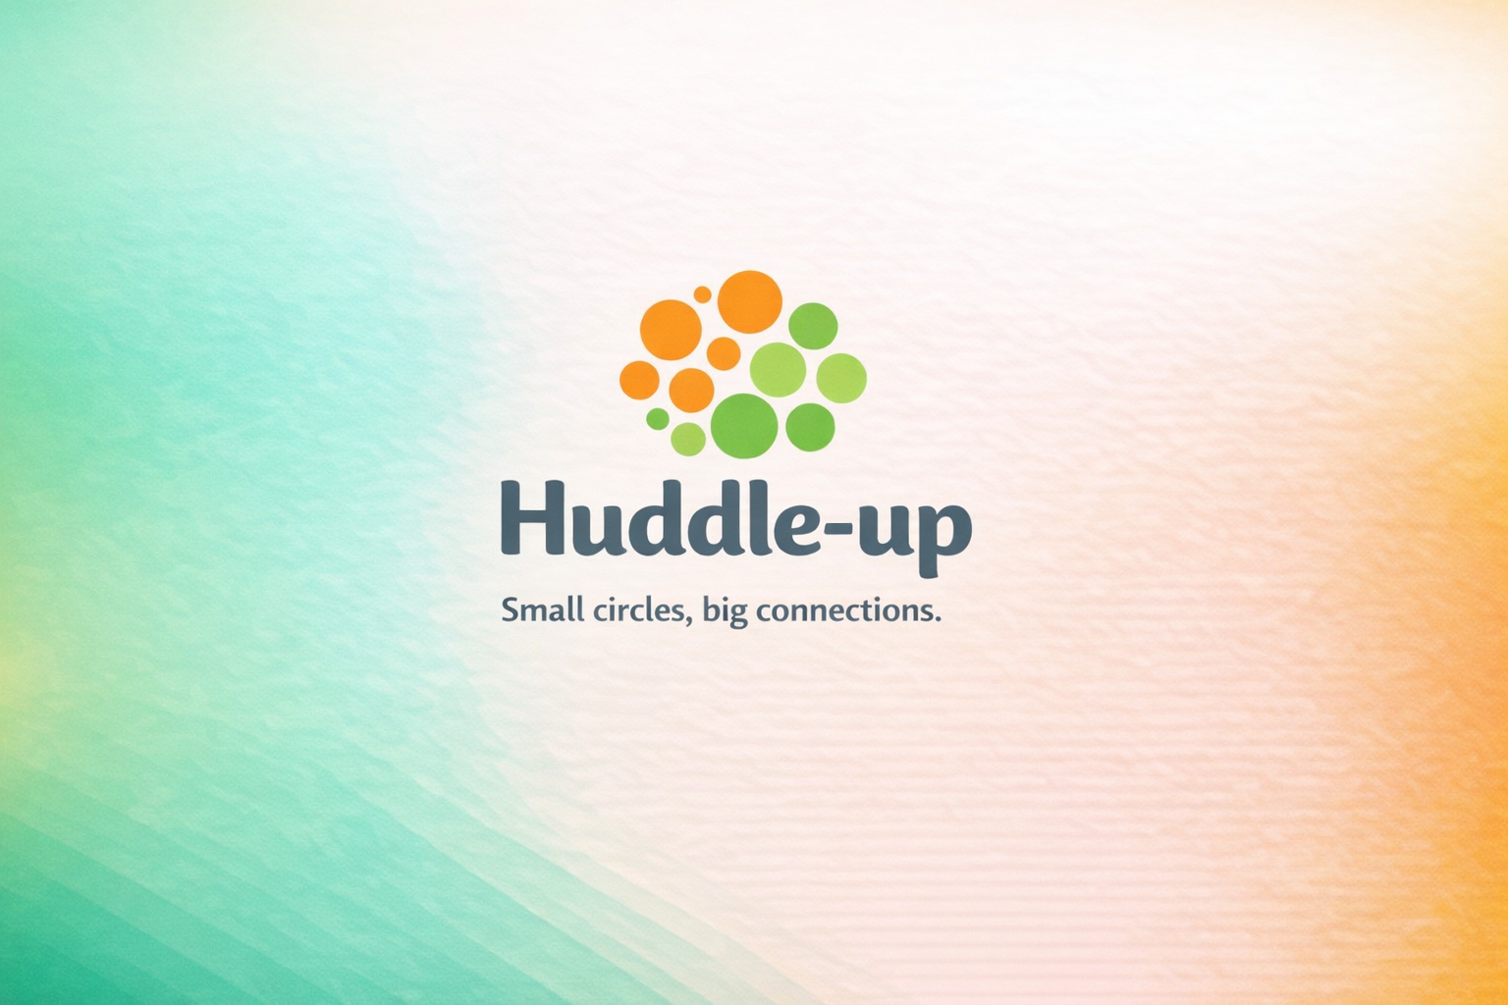
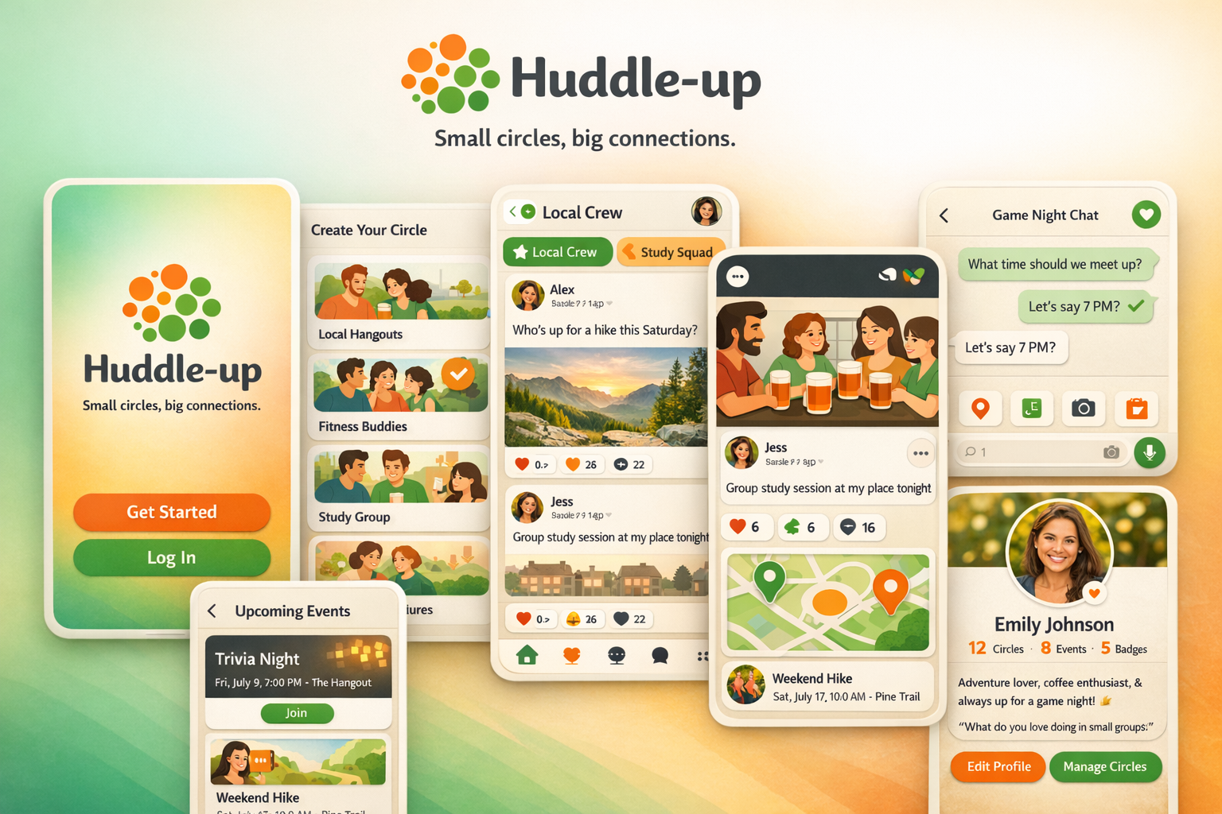
App Prototype Design
Created prototype logo by Microsoft Copilot
Created prototype image by Microsoft Copilot
Notes:
So, for the app prototype, first
The screen first displays
1. Welcome Screen
Background: Smooth gradient from green to orange
Logo: Circular cluster of green and orange dots
Buttons:
Get Started (orange)
Log In (green)
Tagline: Clearly displayed under the logo
Then: 2. Create Your Circle
Purpose: Choose your micro-community
Using the Options shown:
Local Hangouts
Fitness Buddies ✅
Study Group
Local Adventures
Then: 3. Home Feed
Circles featured:
Local Crew
Study Squad
Posts include:
Alex: “Who’s up for a hike this Saturday?”
Jess: “Group study session at my place tonight”
Engagement icons: ❤️ Likes, 🔁 Shares, 💬 Comments
Then: 4. Chat Screen
Circle: Game Night Chat
Messages:
“What time should we meet up?”
“Let’s say 7 PM?”
Quick-action icons:
Location pin
Poll
Photo
Calendar
Then: 5. Events Screen
Upcoming Events:
Trivia Night — Fri, July 9, 7:00 PM
Weekend Hike — Sat, July 17, 10:00 AM
Map preview: Shows hike location
Join button: Clearly visible for RSVP
Then: 6. Profile Screen
User: Emily Johnson
Stats:Huddle-up App Prototype Overview
12 Circles
8 Events
5 Badges
Bio:
“Adventure lover, coffee enthusiast, & always up for a game night!”
Prompt: “What do you love doing in small groups?”
Finally: Buttons are included to:
Edit Profile
Manage Circles
So, the Design of the app is
Colour palette: Soft green and orange tones
Typography: Friendly and modern fonts
Layout: Clean, rounded, and intuitive
Mood: Welcoming, energetic, and community-focused

Slide 7




Competitors and Alternatives
• Facebook Groups: Large and messy; low engagement between members.
• Reddit: Top-based community platform but it’s anonymous, often toxic, not intimacy-driven.
• Discord: Great for chat and gaming communities, but unstructured and mostly gaming-oriented.
• Geneva / Circles / Slack: Great communication tools, but lack gamification and small-group focus.

Slide 8

Financial/Commercial viability
Commercial viability
Revenue streams:
• Freemium model: Free access to basic huddles; premium for unlimited or private huddles.
• Team/enterprise subscriptions: Companies/organisations pay monthly per team huddle.
• Brand-sponsored huddles: For communities around fitness, wellness, learning, etc.
• Merchandise and event tie-ins: Physical meetups, stationery stuff, e.g branded journals, pens/water bottle with logo, digital passes.
Financial viability (Pricing of app subscriptions)
Premium: £10/month per user, includes huddles being created
Business plan: £5/month per user includes team huddles
Free plan: £0, includes joining huddles and inviting others to join huddle

Slide 9

Any questions?
Feel free to ask

Slide 10
The End
Thanks for watching

